Slide 1

BACC 2022
Team Micronsoft
Cao Yuxuan, Jin Cheng Hao, Lee Jing Hong, Lim En Hao
Hwa Chong Institution
Notes:
Good morning judges and all audiences. We are Team Micronsoft from Hwa Chong Institution.

Slide 2
Question 1
Micron’s role &
Impacts on Micron
Notes:
my name is Jing Hong and I shall begin by explaining question 1

Slide 3

Micron’s Role
Redundancy in operations
Globally diversified production has been very helpful because it mitigates the COVID-19 protocols that were impacting production in certain areas
Notes:
Firstly, Micron has in recent months invested heavily in its supply chain to make sure that there is redundancy in operations. Their globally diversified production has also been very helpful in this regard because it mitigates the COVID-19 protocols that were impacting production in certain areas.

Slide 4

Micron’s Role
“US 150 billion, 10-year investment plan”
US Fab expansions and working with governments around the world
Have more autonomy over the sourcing of raw materials and distribution of products.
Help to alleviate shortage by injecting more supply
Notes:
Micron has now come up with a US$150 billion, 10-year investment plan. This includes potential US fab expansion as well as working with governments around the world including Europe where Micron does not have a manufacturing presence in. By doing so, Micron is able to be more self-sufficient. this means that Micron is able to have more autonomy in the sourcing of raw materials and distribution of its products, making it more resistant to supply shocks, therefore enabling it to help alleviate the shortage.

Slide 5

Micron’s Role
Pivotal Role in the retail sector
Many of its major customers depend heavily on the performance of their retail stores
Apple suffered delays in production due to the shortage
Production of its latest model was slashed
Notes:
Micron plays a pivotal role in the retail sector as many of its major customers depend heavily on the performance of their physical stores. One example of which is Apple, in April 2021, the chip shortage led to a slash in the production of Apple's latest iPhone 13.

Slide 6

Impact on Micron
Disrupted supply chains for complementary goods
Micron’s DRAM and NAND chips need to be paired with computing-purpose chips.
This has affected demand for Micron’s products in general.
Tesla has also recently removed USB ports due to the shortage.
Notes:
Global chip shortages have disrupted supply chains for complementary goods, specifically computing-purpose chips produced by other companies to be paired with DRAM and NAND chips to form a complete system. In fact, Tesla, recently had to remove in-cabin USB ports due to a lack of relevant computing chips for it.

Slide 7
Impact on Micron
P
S1
S0
P
S
P1
P0
P0
P1
D
D0
D1
Q
Q
Q1
Q0
Market for complementary chips
Market for DRAM and NAND, Revenue falls
Notes:
Hence, shortages in supply of non-memory chips, a complementary good to memory chips, required for various technological products increases its price as seen from the figure on the left where the supply curve shifts leftwards, the increase in price of complementary chips will lead to a fall in demand and thus revenue for DRAM and NAND chips.

Slide 8
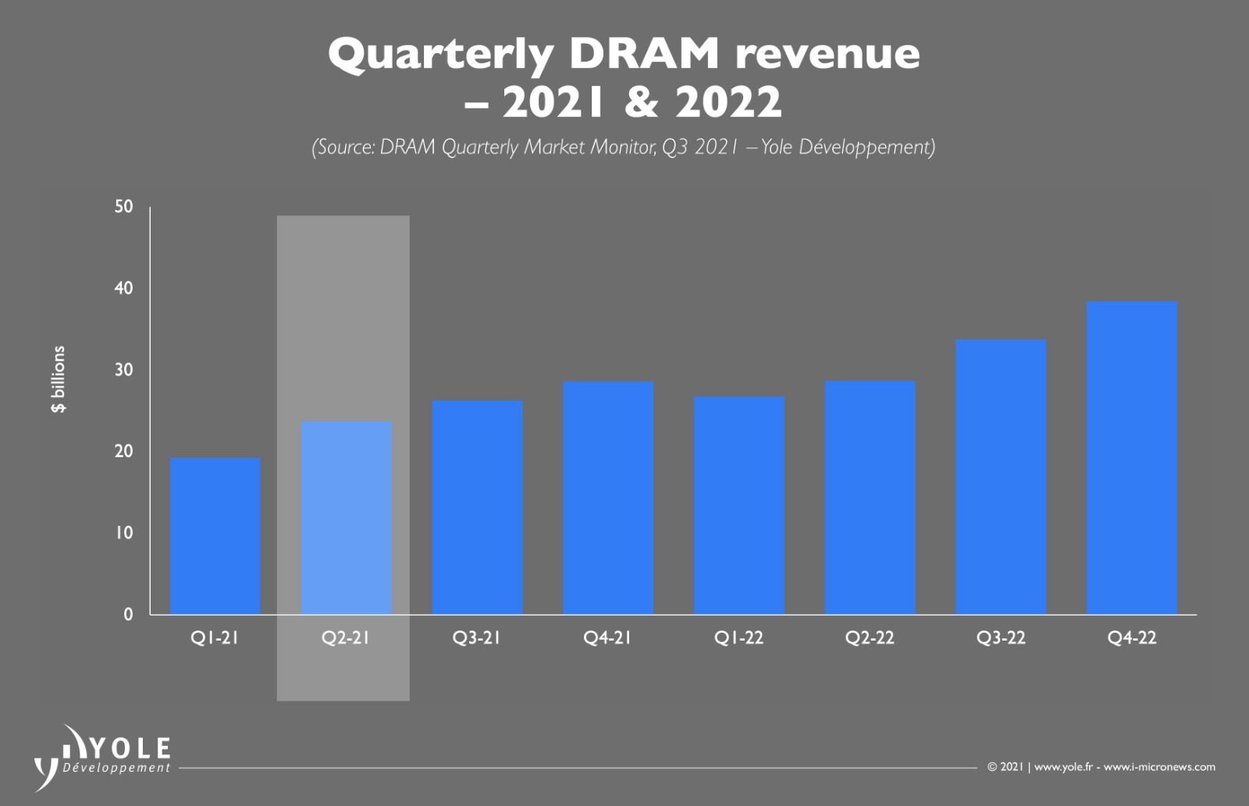
Impact on Micron
Notes:
However, shortages have also resulted in surging memory chip prices. Given the heavy reliance on memory chips for technological products fuelled by recent lockdowns, demand for memory chips is likely price inelastic. Hence, shortages in supply over a price inelastic demand lead to higher revenues for Micron as evidenced by the figure shown in this slide.

Slide 9

Impact on Micron
Expanding production capacity
Micron does not have a fabless model
Not dependent on foundries like TSMC
Avoid large premiums to reserve production
Able to expand on production capacity
Notes:
Unlike most other semiconductor companies, Micron’s business model is not fabless and is therefore less reliant on foundries such as Taiwan Semiconductor Manufacturing Company (TSMC). Hence, Micron can avoid paying large premium sums to reserve production capacity, reducing the impact on its cost of production during the global shortage. Micron is also able to acquire greater production capacity in advance in response to imminent shortages.

Slide 10
Impact on Micron
However, the cost of error for Micron and similar chip production companies has skyrocketed during this shortage, with disruptions incurring greater operational costs due to the need for better emergency planning and response.
Incident of contaminated flash chips from Western Digital factory. WD was forced to respond to sudden cost increases by raising the prices of its affected products.
Notes:
However, the cost of error for Micron and similar chip production companies has skyrocketed during this shortage, with disruptions incurring greater operational costs due to the need for better emergency planning and response. The WD incident is an example.

Slide 11
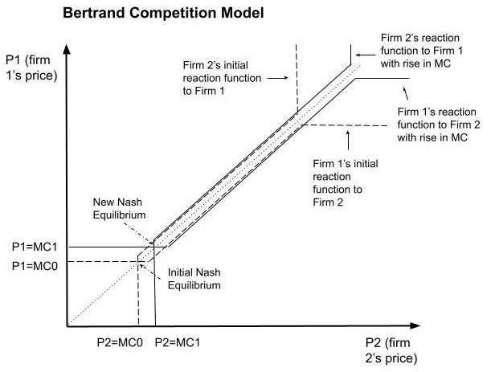
Impact on Micron
Notes:
So, given the fact that the DRAM industry has an oligopolistic market structure as seen from the market dominance by Micron, Samsung and SK Hynix, a uniform increase in cost will lead to higher prices and by extension, higher revenue this is derived from the Bertrand Competition Model of Game Theory which states that higher MC will lead to higher equilibrium price.

Slide 12
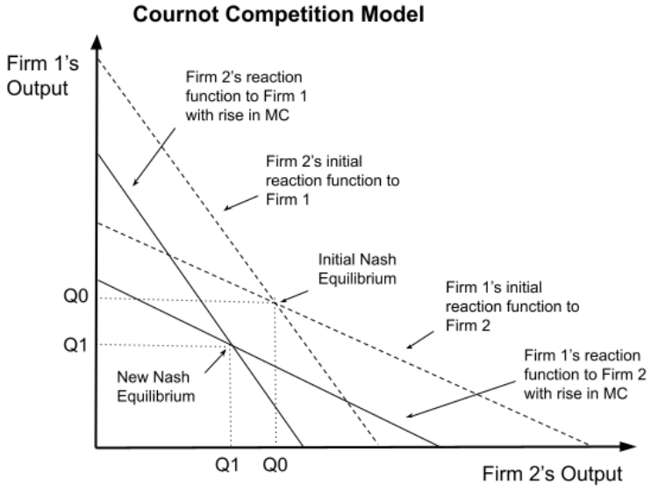
Impact on Micron
Notes:
Lastly, we take a look at the cournot competition model which displays similar outcomes, as the reaction curves of oligopolistic companies shift leftward to respond to an increase in cost. As this model looks at quantity produced, there is a lower total output in the industry and thus a higher price by the law of demand.

Slide 13
Question 2.1
Demand Forecasting
Notes:
Now, I will be explaining the demand forecasting question

Slide 14
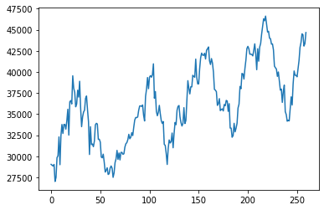
Overview of data
Seasonal trend
Upward trend
Noise
Notes:
Before I begin on our solutions, let’s take a look at the given data. Here we can see that the given demand data has a rather clear periodic trend and repeats itself around every 60 weeks. Overall, we can also see an upward trend.

Slide 15
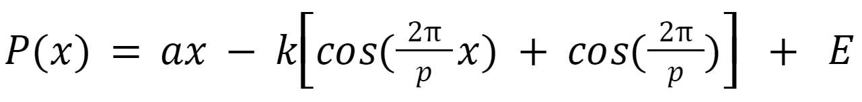
Mathematical Approach
P(x) := prediction function, where the argument is the # of the week being predicted
a := gradient of slope = change in deseasonalized demand data over N timesteps / N
k := amplitude of curve = 0.5 * average peak to trough distance
p := period of curve = 60 (by observation)
E = random variable that follows a Gaussian distribution defined by the standard deviation of error terms between the given values and their 15-week moving average
Notes:
We first approached this question from a mathematical standpoint. We developed this cosine curve based model to simulate the trends and seasonal behaviour of the given data. I will not be going into details on each term in it but we are happy to answer any questions on details of this later.
QnA:
E adds artifical yet realistic noise to the curve and forms a realistic prediction. The artifical noise is statistically meaningful for seeing the range of possible values.

Slide 16
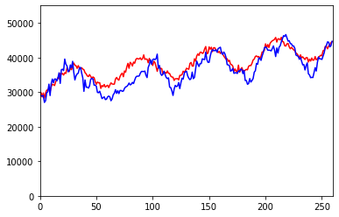
Mathematical Approach
Blue: Truth
Red: Preds
MAE: ~2200
Troughs are sharper while peaks are rounder
Will become increasingly unreliable
Notes:
Using this model, we were able to achieve a MAE of around 2200 on the whole data and we can see that this model is able to follow the general trend reasonably well but lacks in predicting the local minimas. This model will become increasingly unreliable as time passes, since the numerical values and trends will deviate more and more in future and such a fixated model cannot adapt to the changes well.

Slide 17
Deep Learning Approach
Universal Approximation Theorem
Large information receptive field
High degree of non-linearity
Gradient Descent
Can be retrained in future and reused on other products
Performance scales with amount of data
RNN (Recurrent Neural Network) - failed to perform well
MLP (Multi-layer Perceptron)
Notes:
Thus, we directed our attention to deep learning, an increasingly popular and powerful data analytics tool. Inspired by the universal approximation theorem, we hypothesize that Neural Networks are able to adapt to the given dataset better due to its large information receptive field and high degree of non-linearity, driven by its high parameter count. One benefit of neural networks is that it can train automatically by the means of gradient descent, saving us time for manually tuning a maths model. Furthermore, neural networks can be retrained on new data in the future, allowing them to constantly improve themselves and adapt to new trends. This is not possible with mathematical functions modelling and manually adjusting the mathematical function is tedious. We experienmented with two types of neural network, the RNN and MLP. However, RNN failed to perform well so we will not be introducing about it now. We are happy to answer questions on the reason why RNNs failed.

Slide 18
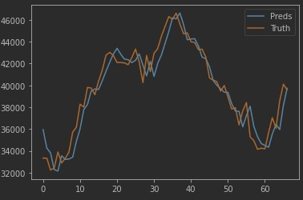
Deep Learning Approach - RNN (LSTM)
Input: past 52 weeks of data in sequence
Output: demand predicted for next week
Split data into train and validation
4 years for train, 1 year for validatation
MAE: 970 on validation set
Model learnt false info of copying previous value
Due to dataset and loss function
Notes:
We first tried the RNN approach as it is more suited for time series data, however we found that RNN will not learn properly due to the nature of dataset and loss function pushing it to learn to simply copy the previous value. Eventually, we are able to get a MAE of 970 on the validation set using RNN. We did find out why RNN fails here but due to time constraint I will not be explaining now. We are happy to answer questions on details of this issue later.
for QnA:
Initially, we treated it as a classic time series forecasting problem in the fields of deep learning. We architected a model based on Long Short Term Memory, a type of RNN where we provide the model with a variable length of input, in this case we fixed it to 52 weeks, and the model predicts the demand for the next week. Following standard deep learning practices, we split the data into a training set and validation set, where the model only learns from the trainng set and validates its performance on the unseen validation set. We used 4 years for training and 1 year for validation. We are able to achieve a MAE of 970 on validation set after some tuning, however when we plotted the predictions, it revealed that the model seems to have learnt the false info of simply copying the previous value. We believe that this is caused by both the simplicity of the dataset and the loss function that we are using. The dataset is highly seasonal and involves prolonged period of constant upward or downward trend and lacks large 'zig-zag' patterns. As we used the MAE as our loss function, this can force the model into learning to copy the value from the previous time step only, as doing this will give the lowest MAE overall, due to the largely same trend between the copied previous timestep and the truth.

Slide 19
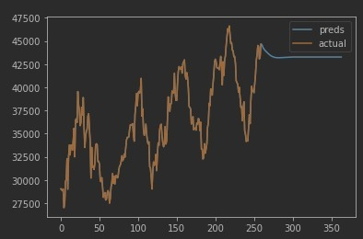
Deep Learning Approach - RNN (LSTM)
Did not work when put to test
There must not be simple sequential pattern
(a, b, c, d) cannot have a relationship where a+b=c, b+c=d etc.
Notes:
As we plot its predictions into the future, this issue become much more obvious, where the predictions converages to a straight line and keep repeating itself. We concluded that there must not be very simple sequential pattern to the data.
For QnA
From our research, we concluded that there must not be very simple sequential pattern to the data, like a list of a b c d where a+b=c, b+c=d etc. This may seem counterintuitive to us as we would think that the value that is the most recent should have the highest importance on determining the next value of a series. While this is true, the model will find that the importance is so large that it starts to disregard all the previous values and just focus on the immediate previous one, resulting in the 'copying' behaviour.

Slide 20
Deep Learning Approach - MLP
Input sequence is not considered thus model will not be naturally biased to more recent data
Prevents ‘copying’ issue in RNN
Consists of Fully Connected (FC) layers
Activation functions in middle to enhance non-linearity
Notes:
To mitigate this issue, we need to feed the historical data in a way that can be treated equally by the model, thus we decided to adopt a more basic way of modelling relationships which is regression, where every timestep inputted matters equally to the model, at least on the surface, before it actually learns which are more important. To do this, we architected a Multi-layer Perceptron model using fully connected layers. To increase the non linearity of the model, we used activation functions in between each FC layer. I will explain more on this later.

Slide 21
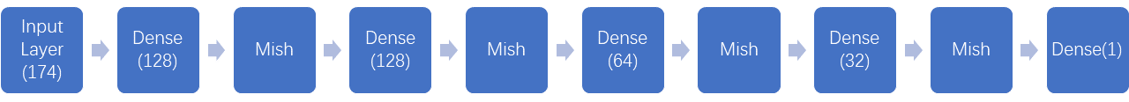
Deep Learning Approach - MLP
Input: past 3 * N weeks where N = period = (52, 58)
Output: demand predicted for next week
Consists of fully-connected (FC) layers and Mish activation in between them
MAE on full data: 244 (N=58), 269 (N=52)
Model ensembling by taking mean of both model’s predictions
Reduces noise
Notes:
We eventually used the MLP approach. We input the past 3 times 52 or 58 weeks and the model predicts the demand for next week. After tuning the model, we are able to obtain a satisfactory MAE of 244 on the training data and 269 for N=52, a near 4 times improvement over the RNN model and 9 times over the maths model. We trained two models using slightly different input sizes and took the mean of their predictions as the final prediction to reduce noise. Here is our model architecture. Dense means 1 layer of fully connected neurons and the number means the number of neurons in that layer. I will not be going into details of how dense layers work here but I am happy to take questions on this later.

Slide 22

Fully Connected Layers (Dense)
y = w · x + b
A single layer contains many neurons
Output fed to each and every neuron in the next hidden layer
Activation function is applied to all outputs before feeding into next layer
Mish activation:
Notes:
Now I will be going into a bit more details on Dense layers. It can be understood as a linear vector function where a weight matrix dot products with the input matrix and then added to a bias to give a output. The weight matrix and bias is to be learnt. The output y is then being fed into each and every neuron in the next FC layer as one of the values in the input matrix x. In between FC layers, we used the mish activation function which is defined like this.

Slide 23
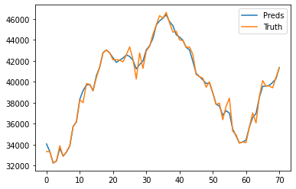
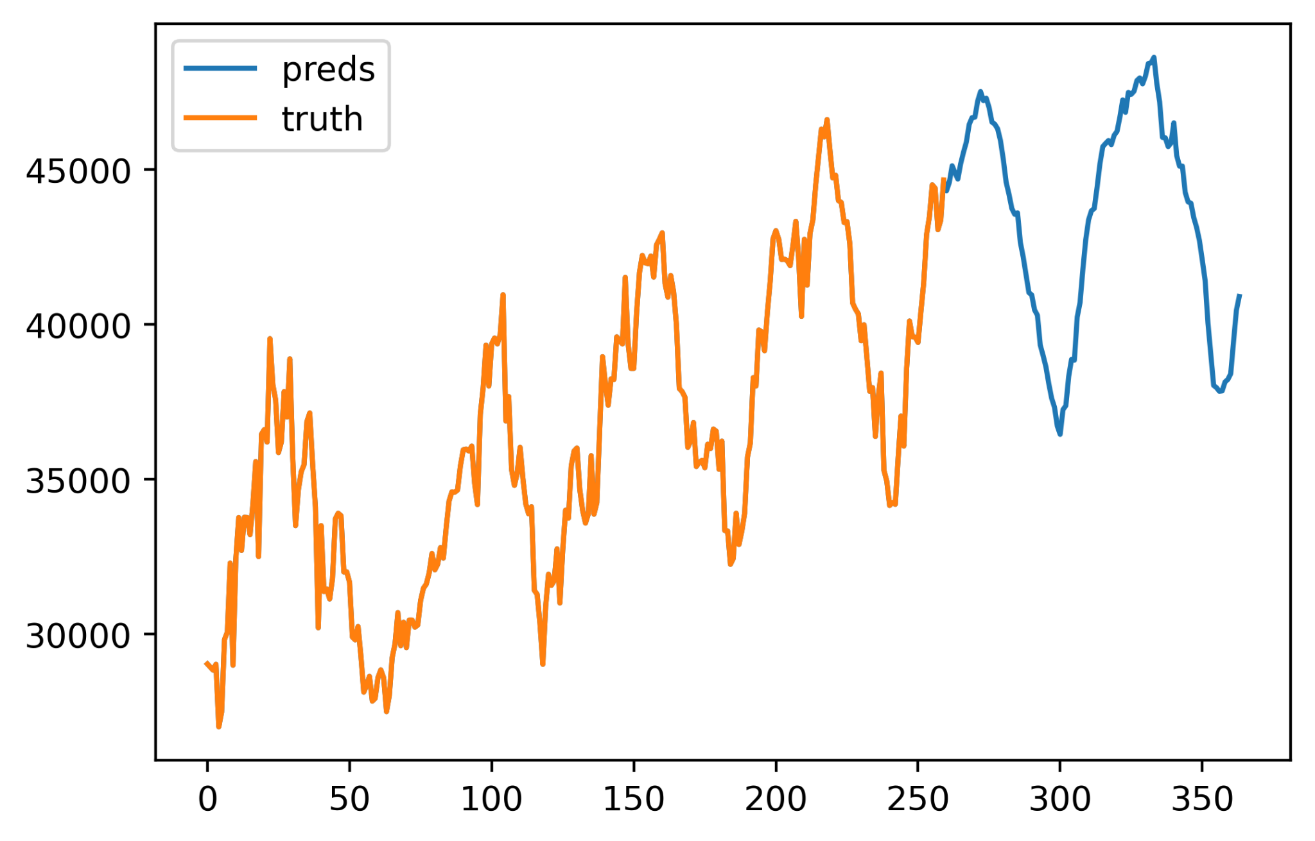
MLP Performance
Notes:
As you can see, our MLP model not only performs near perfectly on the given data, but also gave a very reasonable prediction 2 years into the future. It is able to learn both the seasonal trend and upward trend well.
QnA: why didnt add error term here
the maths model produces strictly smooth curve while MLP can already take noise into account and give noisy prediction like these small spikes when it thinks there is a need, other wise, it will not include. if we manually add noise to this, it will defeat the purpose of nn

Slide 24
MLP Performance
Notes:
Moreover, it can even learn details that us human may not notice. For example, the model learnt from small spikes around these weeks, and predicted similar spikes in the future in the corresponding places.

Slide 25
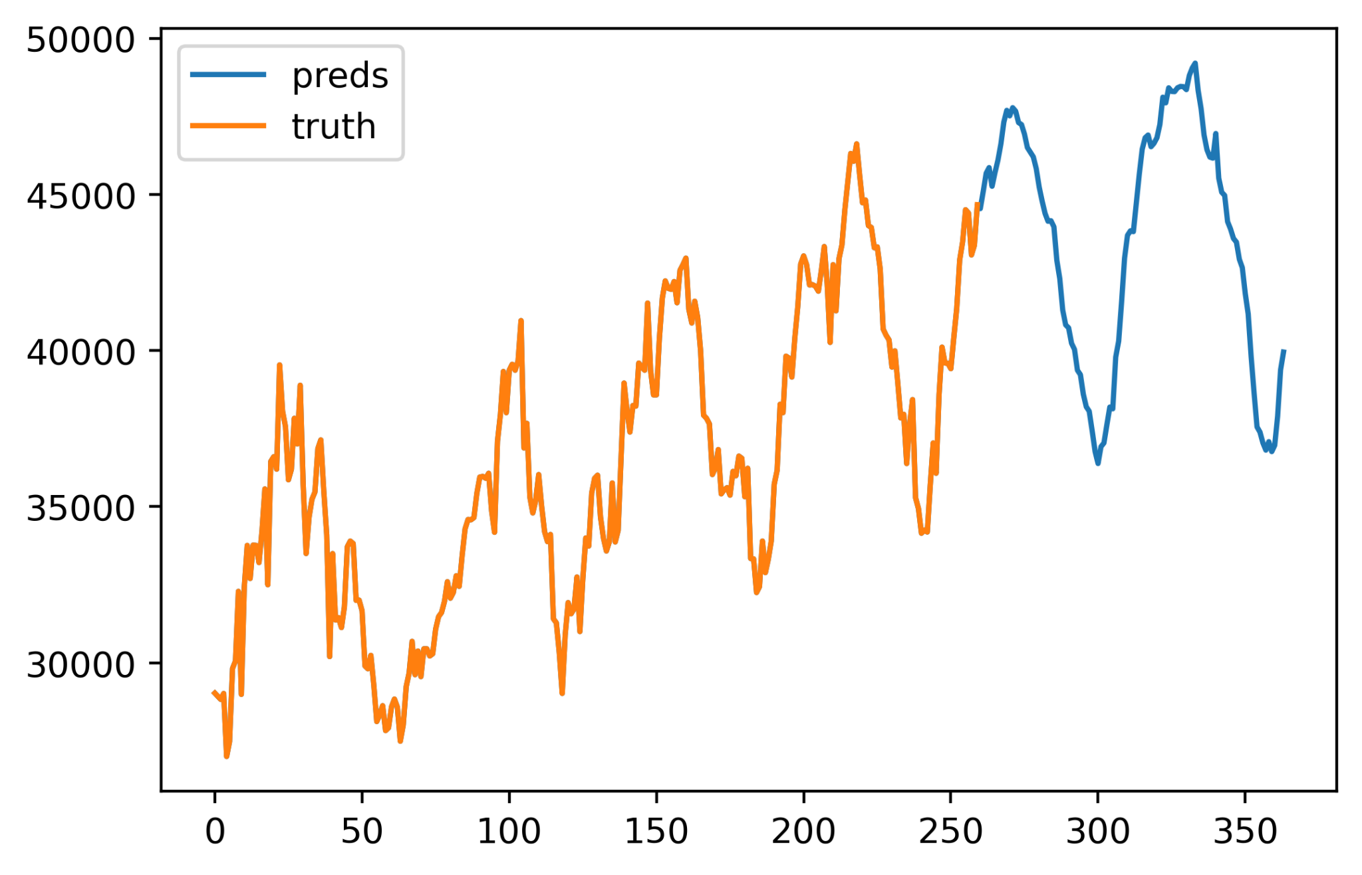
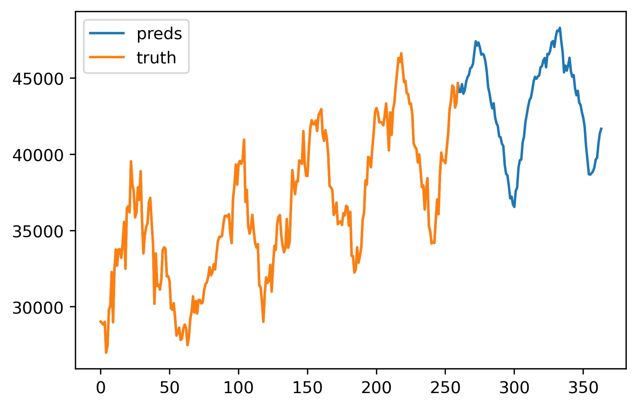
MLP Ensembling
+
Notes:
for QnA only, proof of noise reduction

Slide 26
MLP Limitations
‘Black box’: lack of explainability for human understanding
Provide little value for human analysis on results
Hard to evaluate effectiveness into the future
Random nature of stochastic gradient descent
Not 100% reproducible
Precautionary measures possible
Fixed input size
Reusability depends on amount of data available
Adjustments to model architecture may be needed
Sensitive to data quantity
Scales with # of input features (historical data inputted at once)
May underperform mathematics model when data is too limited
Negligible for this particular task
Notes:
Although our MLP model is able to achieve exceptional performance, it also has its limitations compared to traditional mathematic models. As with most deep learning models, our model lacks explainability for human understanding. Another limitation is the random nature of gradient descent which means each time the model is trained, it produces a slightly different result. Another one is more specific to MLP models, which is that input size is fixed when the model is trained and the performance of it highly depends on the input size and data quantity. In some cases, it may even underperform a traditional maths model. This means that our model may not be reusable on other products with limited data. However, this issue is negligible for this task.
----------------------------------------------------
The most obvious one being its black box nature aka lack of explainability. Due to the number of parameters and weights of our model, it is impossible for humans to understand how the model arrives at conclusions, and thus it provides little to no value in studying the data and drawing insights from it from a human perspective. Another one is the nature of stochastic gradient descent which as the name suggests, is random. Each time the model is trained, even if on exact same data with exact same hyperparameters, the results could vary slightly. Although we employed many techniques like model ensembling to improve the reproducibility of forecasts, it is still not going to be 100% reproducible. Besides the common limitations of all deep learning models, our MLP-approach has another limitation that affects its reusability. The input sizes for MLPs are fixed when the model is trained, and the performance of the model scales proportionally with the number of features or timesteps inputted. This means that for other products with less data, this model architecture cannot be reused directly unless one modifies the input dimensions, which will then greatly impact the model’s performance. In cases where the amount of data available is severely limited, the model may not be able to learn much and may even underperform the traditional mathematical approach, which is much less sensitive to the amount of data available. In the context of this task, this issue is negligible as we do have enough data for effective learning, but in the real world context, it is worth noting.

Slide 27
Question 2.2
Minimum Machine Requirement
Notes:
Now let’s talk about question 2.2.

Slide 28
Formula for Machine Capacity
Combining all the given equations, we get an expression for the Machine Capacity of an individual machine:
Machine Capacity (M)= Availability (A) * RPT Basis (R_{B}) * [Minutes in a week * Utilization (U) / Total RPT (R_{T})] * Load Size (L) = 10080AR_{B}UL/R_{T}
We know that A, U, L, and R_{T} are constants for each type of machine. Therefore, M is a function of R_{B}.
Notes:
In this task, we are asked to calculate the number of machines required to fulfill the demand in each week predicted by our program in the previous task. From the documents, we were given a set of equations to figure out Machine Capacity. We managed to simplify all that into this concise equation here that expresses Machine Capacity M in terms of the RPT Basis of a task, as the other terms are constants for each given model of machine.

Slide 29
Simplifying Assumption
Premise 1: Machines are capable of performing their individual tasks irregardless of the progress of other machines.
Premise 2: Machines can only take one task at a time.
Assumption: Machines must finish all their given tasks in each iteration of the manufacturing process. Thus, we can let R_{B} equal the total RPT basis across all steps for each machine type for each iteration of production and then calculate M.
Notes:
Therefore, the next step is to look for a simplified version of the 100+ steps in the workflow. We know that machines can do their tasks regardless of the progress of other machines, but they must do their own steps sequentially. Therefore, our assumption is that machines will iterate through all their steps in a given batch and move on to the next. Hence, we simply take the sum of all the RPT Basis for a certain machine as the total Rb.

Slide 30
Formula for # of Machines Required
Implication: The number of machines of a certain type required to fulfil the demand is:
Ceil(Forecasted demand in Week N / M)
Example: (Cells are highlighted in green if the current number of machines can supply the forecasted demand and red if there will be a bottleneck in this type of machine)
Albatross | Cattle | Dragon | Flamingo | Grouse | Herring | Peacock | Plovers
Week | Demand | Number of Machines Required (for each Machine Type) to Meet Forecasted Weekly Demand
1 | 44315 | 187 | 276 | 102 | 259 | 83 | 118 | 455 | 575
Notes:
From that, we can calculate the # of machines required in each step by rounding up the forecasted demand divided by total machine capacity as calculated from the total Rb from the previous step. This is an example of our calculations for the first week of our production. Notice how there is already a bottleneck in dragon, flamingo, and grouse, meaning that the demand cannot be met with our current number of machines.

Slide 31
Question 2.3
Optimizing for
Meeting Demand
Notes:
So how do we solve these bottleneck problems? We must look at how Micron can expand their production capacity.

Slide 32
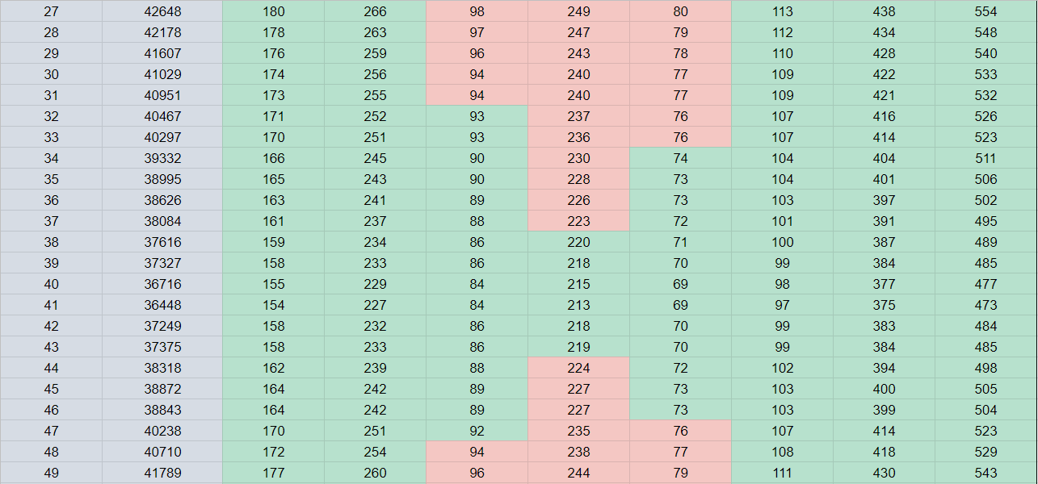
Assumptions
There is no difference if
Micron chooses to buy machines
over different periods of time or if
they buy the total number of extra machines required in the first week
This may not be reflected in the real world as companies have cash flow constraints and risks to consider
Micron wants to spend as little money as they can on buying machines
The demand for chip types within the 2 year period will not change drastically, which would thus allow Micron to produce chips in advance based on predicted demand
Notes:
For this question, we use data from 2.2, and the weeks around the first dip in demand are shown here.
We then make the following assumptions:
Firstly, Micron did not buy machines prior to the start of this question. Under our model, Micron can choose to buy all their machines in the first week. Though this might not be feasible in the real world, the optimal solution we found is still the same under real world circumstances.
The second assumption is crucial: the type of chip people demand will not change drastically in these two years, such that Micron can pre-fabricate some of these chips and sell them at a later date.

Slide 33
Naive Solution
Albatross | Cattle | Dragon | Flamingo | Grouse | Herring | Peacock | Plovers
15 | 21 | 19 | 63 | 16 | 0 | 0 | 36
Micron buys all their required machines in the first week
Take data from 2.2
Maximum # of machines required starting from Week 38 - original #
Reasoning:
Up to Week 38, Micron will not be able to meet demand due to a bottleneck in Flamingo
After Week 38, there will be a second spike in demand starting from approximately Week 44
The total buying and installation time for every machine type will come before their respective machine requirement spikes.
Notes:
We can first look at the naive solution, where we take the projected demand as it is. From the previous picture, we noticed that there is a bottleneck in flamingo until week 38, where we then see the first dip. Starting from week 38, we take the highest number of machines needed and subtract the original number of machines we have from that figure, and we get the number of machines we must purchase in week 1, as shown in this table.

Slide 34
Advanced Solution
W2
W1
Naive:
With production-shifting:
Concept: Production shifting
Under the assumptions, we assume that Micron can pre-produce chips should they predict sufficient demand in the future. Thus, they can shift some production from later weeks to earlier weeks in order to lower the number of machines required in the later weeks. This raises productivity and decreases costs for Micron.
Albatross | Cattle | Dragon | Flamingo | Grouse | Herring | Peacock | Plovers
15 | 21 | 19 | 63 | 16 | 0 | 0 | 36
Albatross | Cattle | Dragon | Flamingo | Grouse | Herring | Peacock | Plovers
0 | 0 | 8 | 41 | 10 | 0 | 0 | 0
Notes:
But that is not an optimal solution.
We can make use of the assumption that they can produce for future demand, meaning that they shift some production to weeks where the machines are not operating at full capacity. Of course, you can only shift production forward, or your customers will be angry. For example, your machine can produce 4 units of chips, but you need to produce 2 units today and 6 units tmr. If you know that the demand will be like this, then you might as well produce 4 units on both days so you don’t need to buy another machine. This means that Micron can save upfront costs and reduce total fixed costs with our strategy. At the same time, they can secure their demand using futures contracts to make this strategy less risky.

Slide 35
Optimal Production Shifting
Let (X, Y) be the # of machines demanded in (week S, week S+1), where X > Y.
Assume ∃M∊ℝ⁺ such that it represents the optimal distribution over a certain subset of weeks where we can theoretically use a fractional number of machines. When we reach week (S+1), assume that it is still in the given subset of weeks; therefore:
|M - X| < 1 & |M - Y| < 1.
Therefore, if we shift any positive integer amount of production from Y to X, and we assume that |M - X| < 1, then it must be the case that M - X + 1 < 1, and thus:
M - Y - 1 < -1 < M - Y. This is a contradiction as we assumed |M - Y - 1| < 1 , therefore week (S+1) is not in the given subset of weeks where M is the optimal distribution.
Notes:
So how does production shifting work, and how much should we shift? We know that the way to lower the number of machines required is to remove outliers and smooth out the curve, therefore we need to take a running average to find out when we should stop shifting production. However, there will be a point at which trying to shift production results in a violation of the rule that we cannot shift demand backwards. This mathematical proof shows that when the running average of machines required for the maximized production of previous weeks is higher than the machines required in the next week, we stop shifting production. The intuitive explanation is that if you produce less in this week than the running average, adding it into the running average increases the production of this week, therefore you essentially shifted production from previous weeks to now, violating the backward shift rule. Using this optimization method, we managed to calculate the results shown in the previous slide, allowing Micron to save a lot of money.

Slide 36
THANK YOU
Notes:
We’ve come to the end of our presentation. Thank you for your attention and we now open the floor to questions.

